Slide 1
Column Family Databases

Slide 2
Database partitioning
Data is too big for one machine
Traditional relational database has 2 choices
Row based
Column based

Slide 3
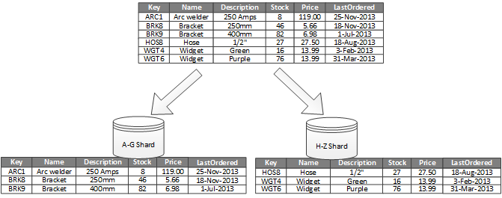
Traditional Sharding – Row based

Slide 4
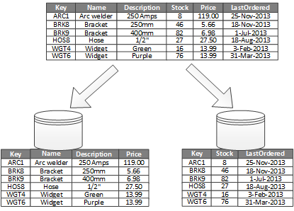
Columnar

Slide 5
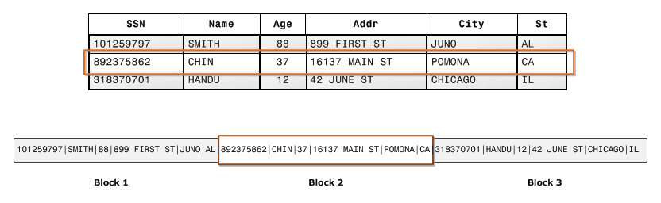
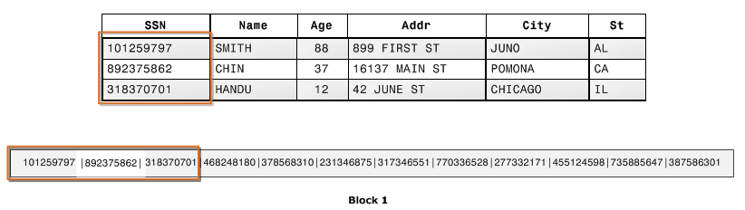
Which should I choose?
It depends…
Consider storage
Which is better for
Update single person
Add person
Calculate average age
Find all cities

Slide 6
What about NoSQL?
Key-Value store
Only one column
Basically row oriented
Document DB
Document is all stored together
Essentially row oriented
Is there any other choice?

Slide 7
Column Family Databases
Consider it as another evolutionary step
Has features of key-value and document stores
Horizontally scalable
Changeable schema between rows
Can partition based on rows and columns
Think of it as a table that is rows of python dictionaries
Google Big Table
Hadoop Hbase
Apache Cassandra

Slide 8
BigTable: A Distributed Storage System for Structured Data

Slide 9
Introduction
BigTable is a distributed storage system for managing structured data.
Designed to scale to a very large size
Petabytes of data across thousands of servers
Used for many Google projects
Web indexing, Personalized Search, Google Earth, Google Analytics, Google Finance, …
Flexible, high-performance solution for all of Google’s products

Slide 10
Motivation
Lots of (semi-)structured data at Google
URLs:
Contents, crawl metadata, links, anchors, pagerank, …
Per-user data:
User preference settings, recent queries/search results, …
Geographic locations:
Physical entities (shops, restaurants, etc.), roads, satellite image data, user annotations, …
Scale is large
Billions of URLs, many versions/page (~20K/version)
Hundreds of millions of users
100TB+ of satellite image data

Slide 11
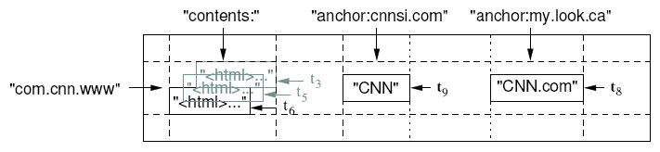
Basic Data Model
A BigTable is a sparse, distributed persistent multi-dimensional sorted map
(row, column, timestamp) -> cell contents
Want to keep copy of a large collection of web pages and related information
Use URLs as row keys
Various aspects of web page as column names
Store contents of web pages in the contents: column under the timestamps when they were fetched.

Slide 12
Tablets
Large tables are broken into tablets at row boundaries
Tablet holds contiguous range of rows
Clients can often choose row keys to achieve locality
Aim for ~100MB to 200MB of data per tablet
Serving machine responsible for ~100 tablets
Fast recovery:
100 machines each pick up 1 tablet for failed machine
Fine-grained load balancing:
Migrate tablets away from overloaded machine
Master makes load-balancing decisions

Slide 13
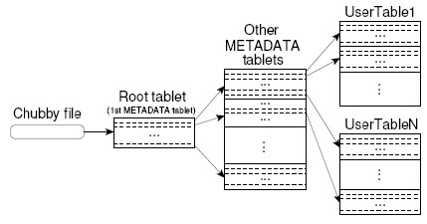
Tablet Location
Since tablets move around from server to server, given a row, how do clients find the right machine?
Need to find tablet whose row range covers the target row

Slide 14
API
Metadata operations
Create/delete tables, column families, change metadata
Writes (atomic)
Set(): write cells in a row
DeleteCells(): delete cells in a row
DeleteRow(): delete all cells in a row
Reads
Scanner: read arbitrary cells in a bigtable
Each row read is atomic
Can restrict returned rows to a particular range
Can ask for just data from 1 row, all rows, etc.
Can ask for all columns, just certain column families, or specific columns

Slide 15
HBase
15

Slide 16

HBase: Overview
HBase is a distributed column-oriented data store built on top of HDFS
HBase is an Apache open source project whose goal is to provide storage for the Hadoop Distributed Computing
Data is logically organized into tables, rows and columns
16

Slide 17
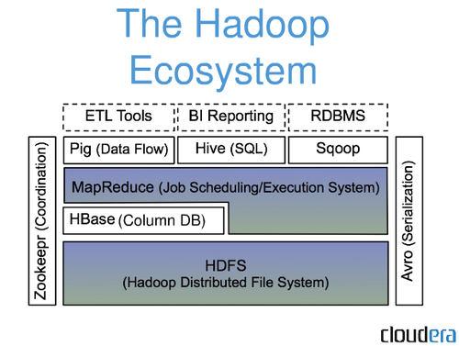

HBase: Part of Hadoop’s Ecosystem
HBase is built on top of HDFS
HBase files are internally stored in HDFS
17

Slide 18
HBase vs. HDFS
Both are distributed systems that scale to hundreds or thousands of nodes
HDFS is good for batch processing (scans over big files)
Not good for record lookup
Not good for incremental addition of small batches
Not good for updates
HBase is designed to efficiently address HDFS issues
Fast record lookup
Support for record-level insertion
Support for updates (not in place)
HBase updates are done by creating new versions of values
18

Slide 19
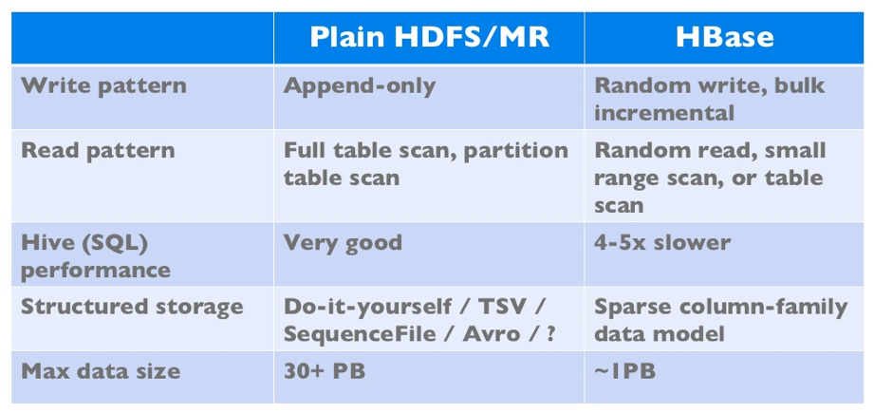
HBase vs. HDFS (Cont’d)
If application has neither random reads or writes ➔ Stick to HDFS
19

Slide 20
HBase Data Model
20

Slide 21
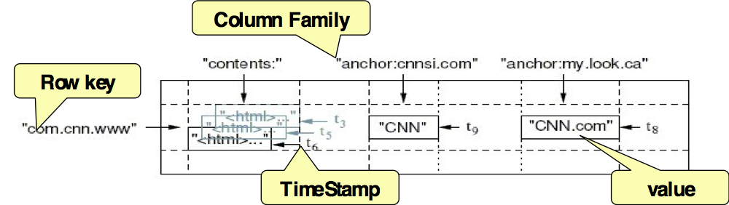
HBase Data Model
HBase is based on Google’s Bigtable model
Key-Value pairs
21

Slide 22
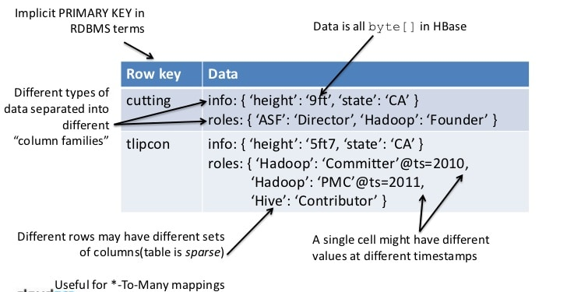
HBase Logical View (2 level key-value store)
22

Slide 23
HBase Physical Model
23

Slide 24
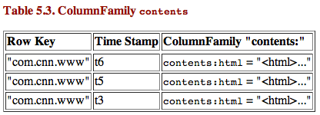
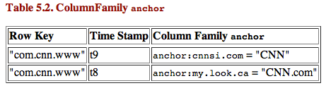
HBase Physical Model
Each column family is stored in a separate file (called HTables)
Key & Version numbers are replicated with each column family
Empty cells are not stored
HBase maintains a multi-level index on values:
<key, column family, column name, timestamp>
24

Slide 25
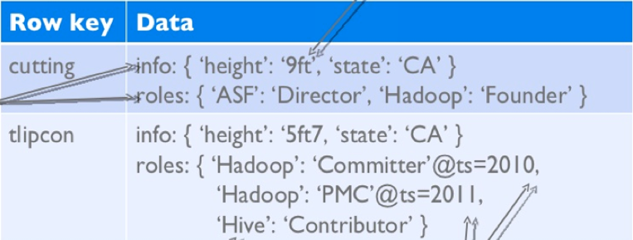
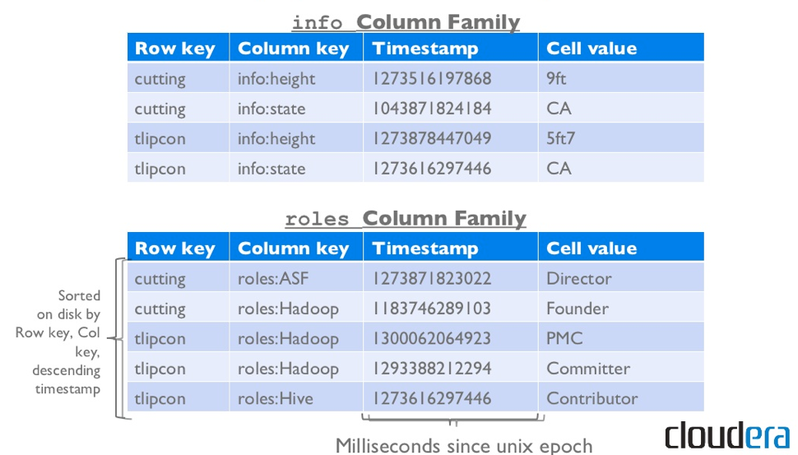
Example
25

Slide 26
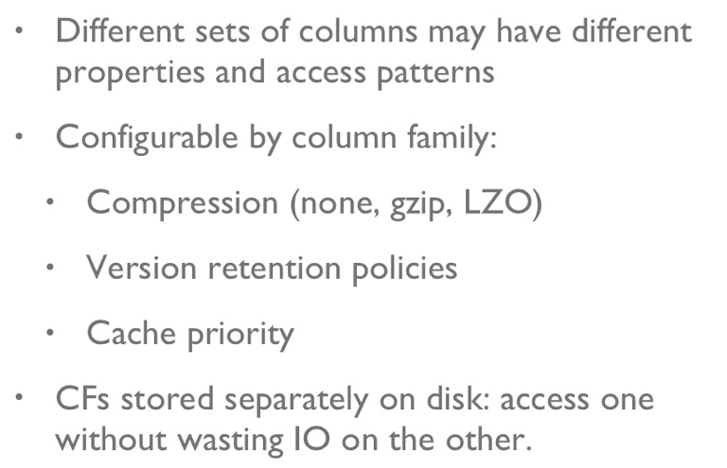
Column Families
26

Slide 27
HBase Regions
Each HTable (column family) is partitioned horizontally into regions
Regions are counterpart to HDFS blocks
Each will be one region
27

Slide 28
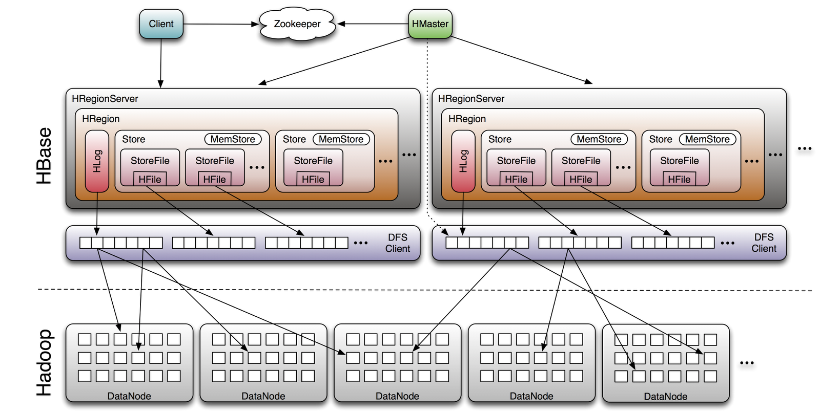
Big Picture
Responsible for coordinating the workers
Assigns regions, detects failures
Admin functions
Manages data regions
Serves data for reads and writes (using a log)
28

Slide 29
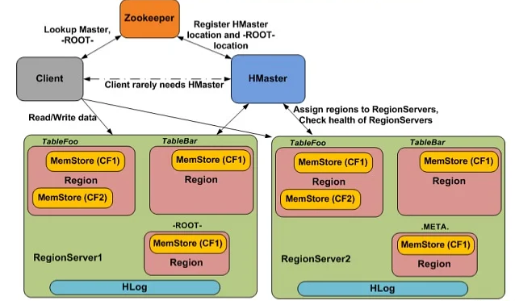
ZooKeeper
HBase depends on ZooKeeper
Distributed coordination service
By default HBase manages the ZooKeeper instance
E.g., starts and stops ZooKeeper
HMaster and HRegionServers register themselves with ZooKeeper
ZooKeeper keeps track of them
Client needs to access ZooKeeper quorum in order to connect with region servers and HMaster
29

Slide 30
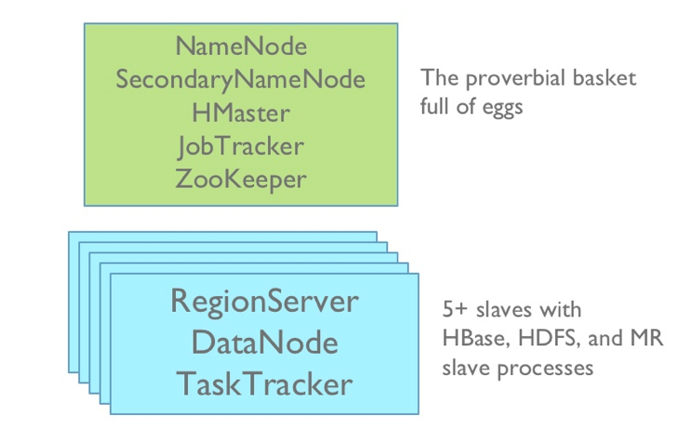
HBase Deployment
Master
node
Slave
nodes
30

Slide 31
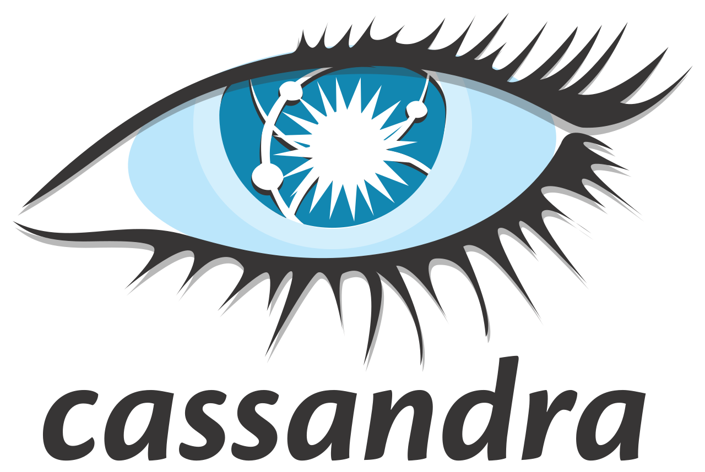
Apache
Gary Dusbabek
Rackspace

Slide 32

Cassandra History
Developed at Facebook
Used for Inbox search, etc.
Combine the ideas of
Amazon Dynamo
Google BigTable
Document Databases
Moved to Google code in 2008
Became Apache project in 2009

Slide 34
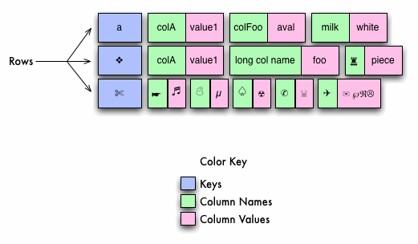
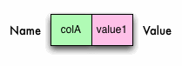
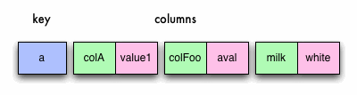
Cassandra Data Model
A single column
A single row

Slide 35
Data Model
ColumnFamily: Rockets
Key
Value
1
Name
Value
name
Rocket-Powered Roller Skates
toon
Ready, Set, Zoom
inventoryQty
5
brakes
false
2
Name
Value
name
Little Giant Do-It-Yourself Rocket-Sled Kit
toon
Beep Prepared
inventoryQty
4
brakes
false
3
Name
Value
name
Acme Jet Propelled Unicycle
toon
Hot Rod and Reel
inventoryQty
1
wheels
1

Slide 36
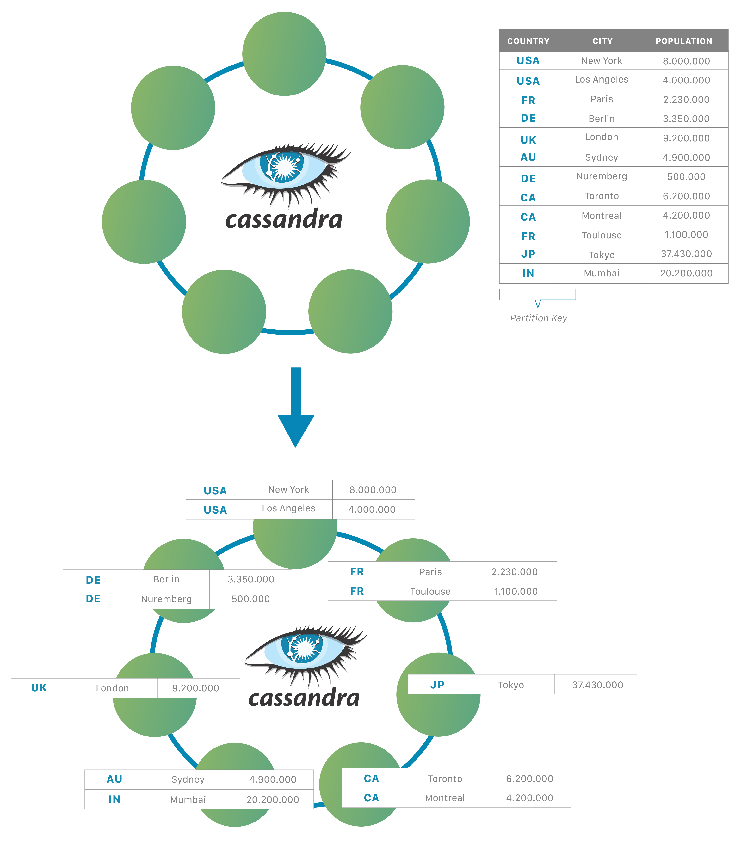
Consistency & Replication
Based on Dynamo’s model
Consistent Hashing
Virtual nodes hashed into the ring
Data hashed into the ring
User chooses partition key
Replication
Admin defines replication factor
Replicated around the ring
Tunable consistency
User defines quorum size for writes
Can be defined on a per-write basis

Slide 37
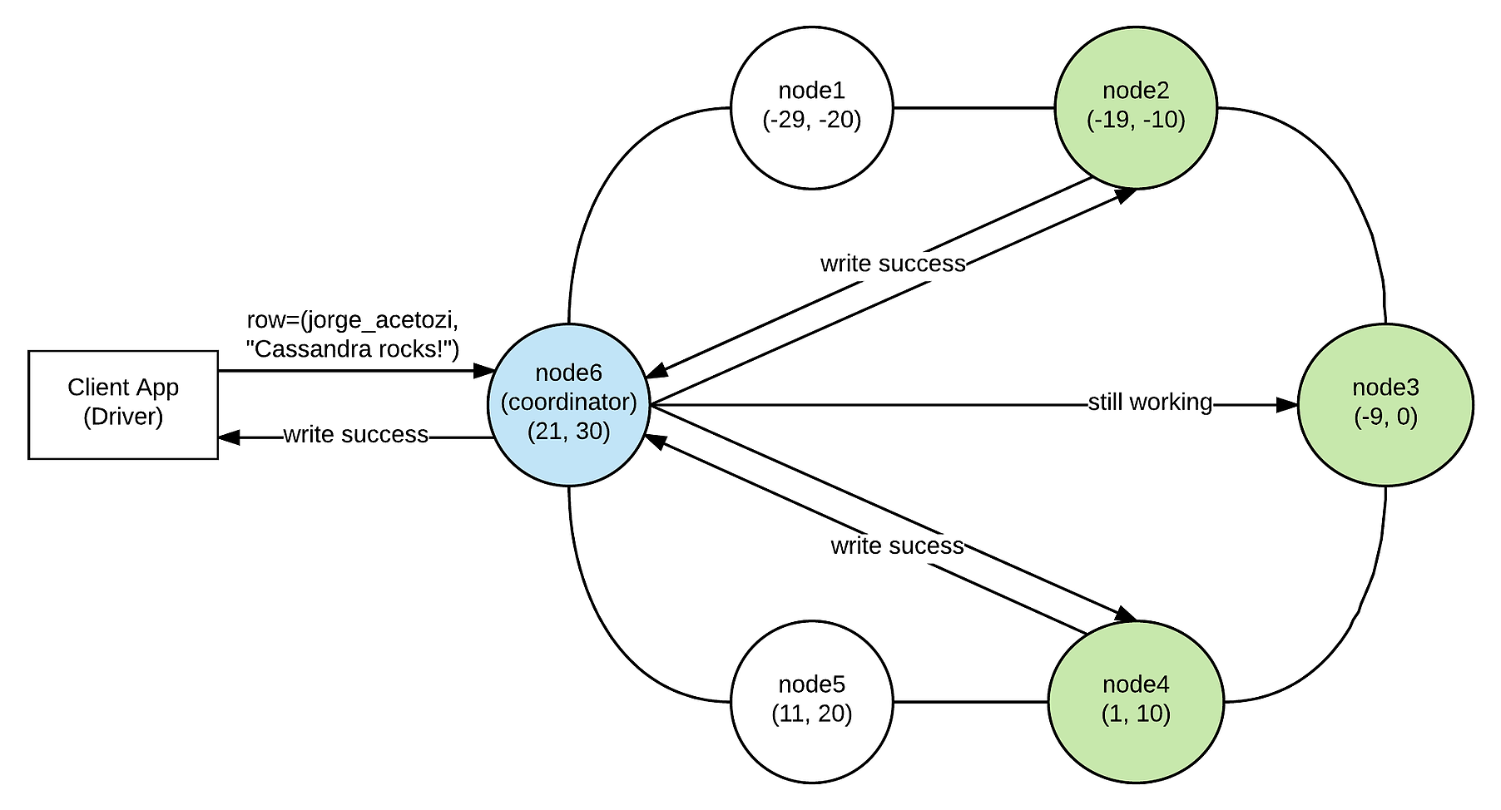
Cassandra Writes
Client can interact with any node
Tunable consistency

Slide 38
In-memory table
Append-only
Replay to restore
downed node’s
memtables
Sorted String Tables on disk
Memtable snapshots
Updates can change Memtable entries but not SSTables – thus the need for periodic compaction

Slide 39
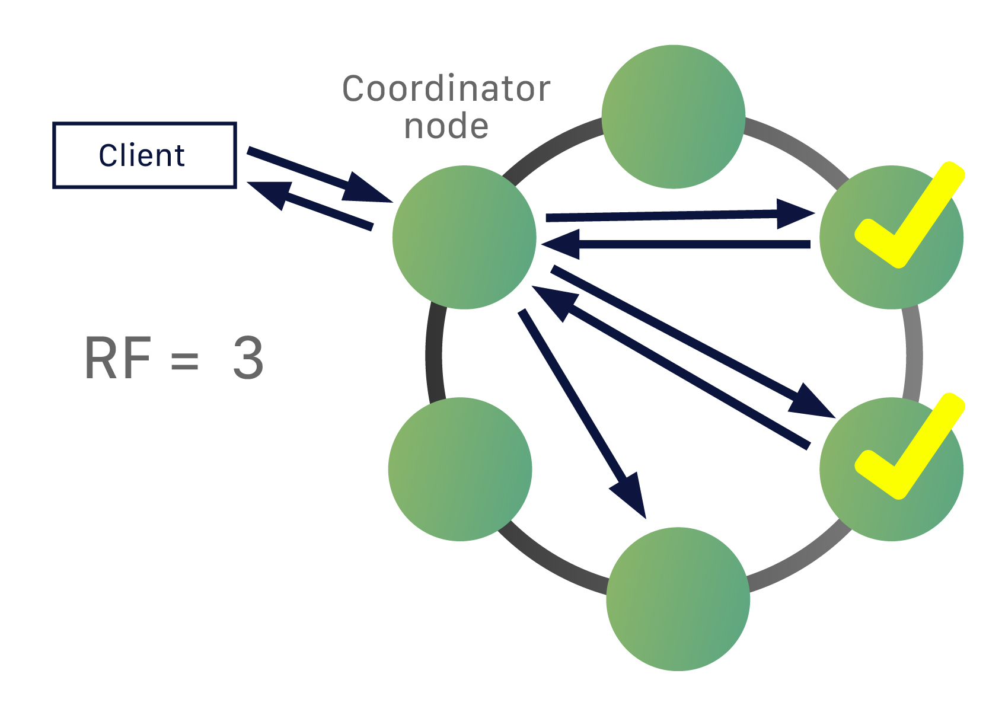
Cassandra Reads
Client can interact with any node
Tunable consistency

Slide 43
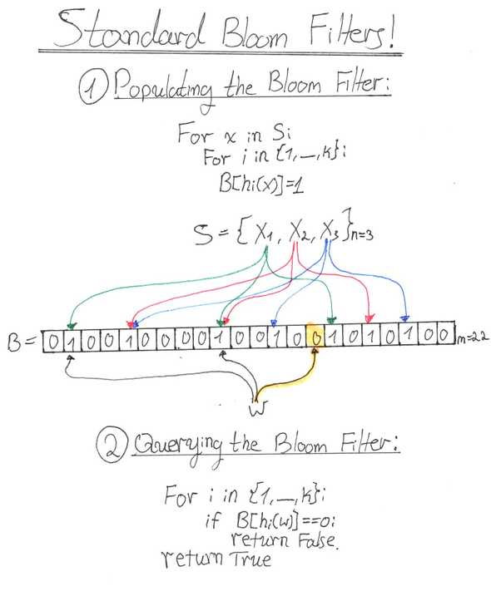

Slide 44
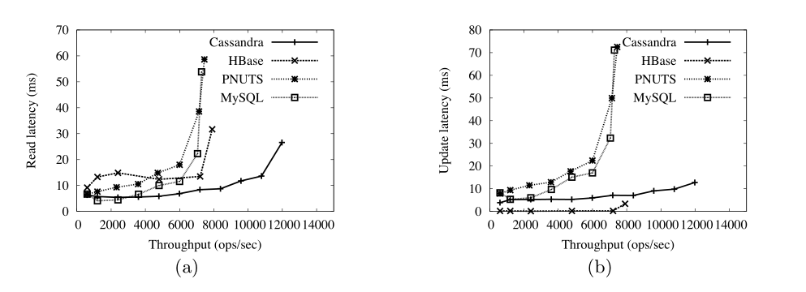

Slide 45
Using Cassandra
CQL – Cassandra Query Language
Very much like SQL
Allows for basic SQL data types and
List
Map
Set
CRUD operations
Insert – very much like SQL
An INSERT query with the same primary key as existing data would result in updating the row
Select – very much like SQL select from where
Update is the same as insert
Delete marks the data for removal – tombstone
Wait for compaction

Slide 46
Cassandra Create
Looks similar to SQL CREATE:
PRIMARY KEY looks a little different, though…
By default the partition key is the first column of a composite key:
But what about rows that have different columns?
Typically, define all the potential columns
But a row is stored as a sparse row
No empty columns are stored
CREATE TABLE state_theater (
state VARCHAR,
city VARCHAR,
theaters INT,
PRIMARY KEY ((state), city)
);
Partition Key
PRIMARY KEY ((part1, part2), pk3)
PRIMARY KEY (state, city) = PRIMARY KEY ((state), city)

Slide 47
Cassandra Data Layout
Cells
Key
Value
Partitions
Partition Key

Slide 48
Cassandra Data Layout
CREATE TABLE pubs_by_year_title
(published INT,
title TEXT,
author TEXT,
genre TEXT,
id INT,
PRIMARY KEY ((published), title)
);
2014 | I did DBCC you coming : author | I did DBCC you coming : Genre
 | O. DeeBeaSea | Horror
 | Slow train to SOS_Scheduler : author | Slow train to SOS_Scheduler : Genre
 | R.T. Fishall | Humour
2015 | Mamma Mia ! That index… !! : author | Mamma Mia ! That index… !! : Genre
 | Richard Munn | Horror
 | Plan the plan's planny plan : author | Plan the plan's planny plan : Genre
 | A. Noob | Management

Slide 49
Cassandra “Got ya’s”

Slide 50
Partitioning Hot Nodes
A “hot node” is a node that is working harder than the others
Be careful of using partition keys that have an abnormally high amount of data compared to others
Example, partition key of (city):
New York has an abnormally high amount of shows leading to Node 1 handling more queries than Node 2.
Node 1 - Table: shows
Node 2 - Table: shows
city | show | actors
New York | Fiddler on the Roof | 30
New York | Les Miserables | 40
New York | The Lion King | 45
New York | School of Rock | 35
Milwaukee | The Lion King | 45
city | show | actors
Madison | School of Rock | 35
Portland | Fiddler on the Roof | 30
Denver | Les Miserables | 40

Slide 51
Query Limitations
WHERE clauses can only contain primary key or indexed columns and the partition key must be included in full
Example:
Primary Key
Partition Key
state | city | area | section | voters
WI | Milwaukee | 1 | 2 | 25000
WI | Milwaukee | 2 | 2 | 50000
NY | New York | 3 | 1 | 100000
MN | Minneapolis | 2 | 1 | 35000
SELECT * FROM census WHERE state = ‘WI’; -- Invalid, missing ‘city’ from partition key
SELECT * FROM census WHERE state = ‘WI’ AND city = ‘Milwaukee’; -- Returns 2 rows
SELECT * FROM census WHERE state = ‘WI’ AND city = ‘Milwaukee’ AND section = 2; -- Invalid, must include ‘area’
SELECT * FROM census WHERE state = ‘WI’ AND city = ‘Milwaukee’ AND area = 1 AND section = 2; -- Returns 1 row

Slide 52
Consider Queries When Designing Schemas
Due to query limitations you should consider how you will use your data when designing the schema
Denormalization isn’t bad!
Can’t decide on a good single table schema? Add the data you need to an additional table!
user
user_id | username
00000000-0000-0000-0000-000000000001 | erikd
00000000-0000-0000-0000-000000000002 | bq
user_id_lookup
username | user_id
erikd | 00000000-0000-0000-0000-000000000001
bq | 00000000-0000-0000-0000-000000000002

Slide 53
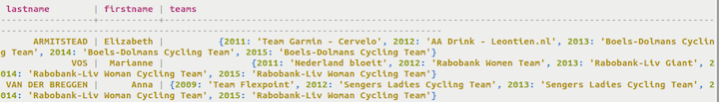
Be Careful of Collections
Collections are really neat and powerful!
Set, List, Map
Example: CREATE TABLE cycling.cyclist_teams ( id UUID PRIMARY KEY, lastname text, firstname text, teams map<int,text> );
If they grow too large they can degrade performance.
Collections are fetched as a whole when retrieving them so the larger they are the more data needs to be fetched.
Observe the following limitations of collections:
Never insert more than 2 billion items in a collection, as only that number can be queried.
The maximum number of keys for a map collection is 65,535.
The maximum size of an item in a list or a map collection is 2GB.
The maximum size of an item in a set collection is 65,535 bytes.
Keep collections small to prevent delays during querying.
Collections cannot be "sliced"; Cassandra reads a collection in its entirety, impacting performance. Thus, collections should be much smaller than the maximum limits listed. The collection is not paged internally.
Lists can incur a read-before-write operation for some insertions. Sets are preferred over lists whenever possible.

Slide 54
Be Careful of too Many DELETEs
When data is deleted a tombstone is placed
During compaction, files on disk are optimized and space is reclaimed
The more DELETEs happen the more data needs to be compacted.
Tombstones can only be deleted if all values for a specific row are all being compacted
There are major and minor compactions, minor compactions may not remove all tombstoned data.
Major compactions are started manually so they aren’t run often

Slide 55
Eventual Consistency
Data is not stored on all replication nodes atomically, it will eventually be replicated to other nodes
Replication is typically on the order of milliseconds but in the case of a write collision, last write wins
A replication factor can be specified when creating a Keyspace to define how many times data will be replicated
A replication strategy determines how data will be replicated to the replication factor
Use NetworkTopologyStrategy if you have more than one data center

Slide 56
Configurable Read/Write Consistency
Each read and write query can specify a consistency level to allow better control over availability of data
Common consistency levels:
ALL – All nodes in the cluster must confirm (even non-local nodes)
QUORUM – A quorum of nodes (half the replication factor plus one) in the cluster must confirm
ONE / TWO / THREE – One, two or three nodes in the cluster must confirm
LOCAL_QUORUM – A quorum of nodes in the local data center must confirm
LOCAL_ONE – One node in the local data center must confirm
First set the consistency by running command:
CONSISTENCY QUORUM;
and then then run your query:
SELECT * FROM users WHERE state='TX’
At any point you can check the consistency using:
CONSISTENCY;

Slide 57
Conceptual Modeling in Cassandra

Slide 58
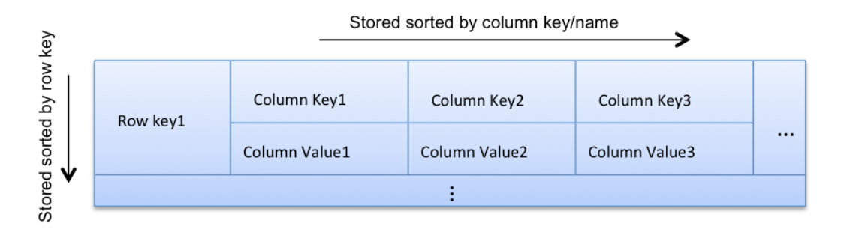
The Conceptual Model
Don’t think relational table. Instead, think nested sorted map
A row key maps to a row, the column keys in a row are sorted, can be nested
A map gives efficient key lookup, and the sorted column keys gives efficient range scans

Slide 59
Data Modelling in Cassandra
Model column families around query patterns
Secondary indexes and complex SQL (JOIN, ORDER BY, GROUP BY) will not work as they do in your favorite RDBMS
Identify the most frequent query patterns and isolate the less frequent
Consider which queries are sensitive to latency and which are not
But, start your design with entities and relationships
It is important to understand and start with entities / relationships, then evolve the model around query patterns, by de-normalizing and duplicating
Remember the model of the nested sorted map, and think how you can organize data into that map in order to satisfy your query requirements, e.g., fast look-up, ordering, grouping, filtering
When you hold a hammer, everything looks like a nail

Slide 60
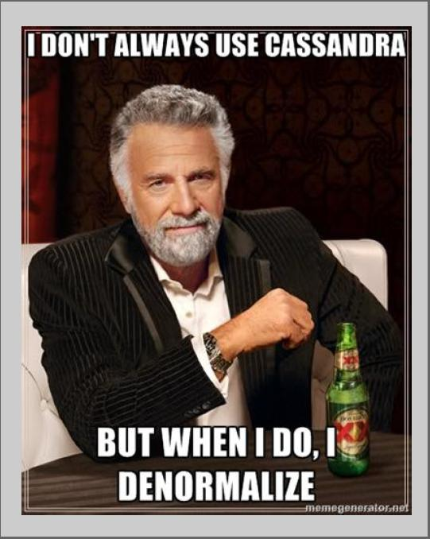
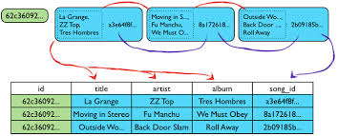
De-normalization
De-normalize and duplicate for read performance
But don’t de-normalize if you don’t need to. It’s about finding the right balance
Remember:
Speed is important
Disk is cheap
The best analogy for this process is the Oracle materialized view. Instead of just storing pointers to data, a materialized view makes a true copy of the data. You should expect to have multiple copies of (part of) your data

Slide 61
Row and Column Keys
Make sure row key and column key are unique
Otherwise, data could get accidentally overwritten
There is no in-place update in Cassandra - it is always an upsert
If you accidentally insert data with an existing row or column key, the previous value will be silently overwritten without any error. The change will not be versioned, and the old data will be gone
(A secret: the data is still there until the next compaction – you just can’t read it)
Last write wins
Keep the column name short
Because it is stored repeatedly
Max column key (and row key) size = 64KB
Storing values in column names is perfectly OK
Motivation: column names are stored in sort order, but column values are not

Slide 62
Parent-child relationships
Since Cassandra doesn’t have foreign keys how would I model a parent / child relationship between data?
As an example, this is how you could model a number of companies and their employees:
This schema would allow you to query the employee table using the company_id to retrieve all the employees for a specific company.
Table: company, Primary Key: (company_id)
company_id | name
1 | ShoreTel
2 | Erik’s Company
Table: employee, Primary Key: ((company_id), employee_id)
company_id | employee_id | first_name | last_name
1 | 1 | John | Doe
1 | 2 | Jane | Doe
2 | 3 | Erik | Davidson
2 | 4 | Grace | Hopper

Slide 63
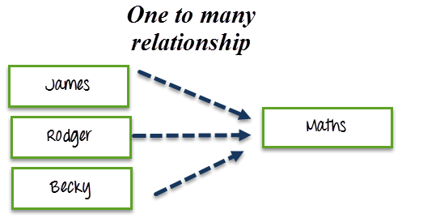
One-to-many & many-to-one relationships
Denormalize
Duplicate the data in the table – based on the query needs

Slide 64
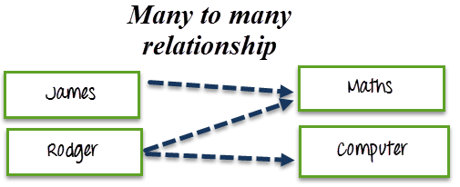
Many-to-many relationships
Think of it as multiple many-to-one relationships
Denormalize
In this case, create 2 one-to-many tables
Student-Course
Course-Student

Slide 65
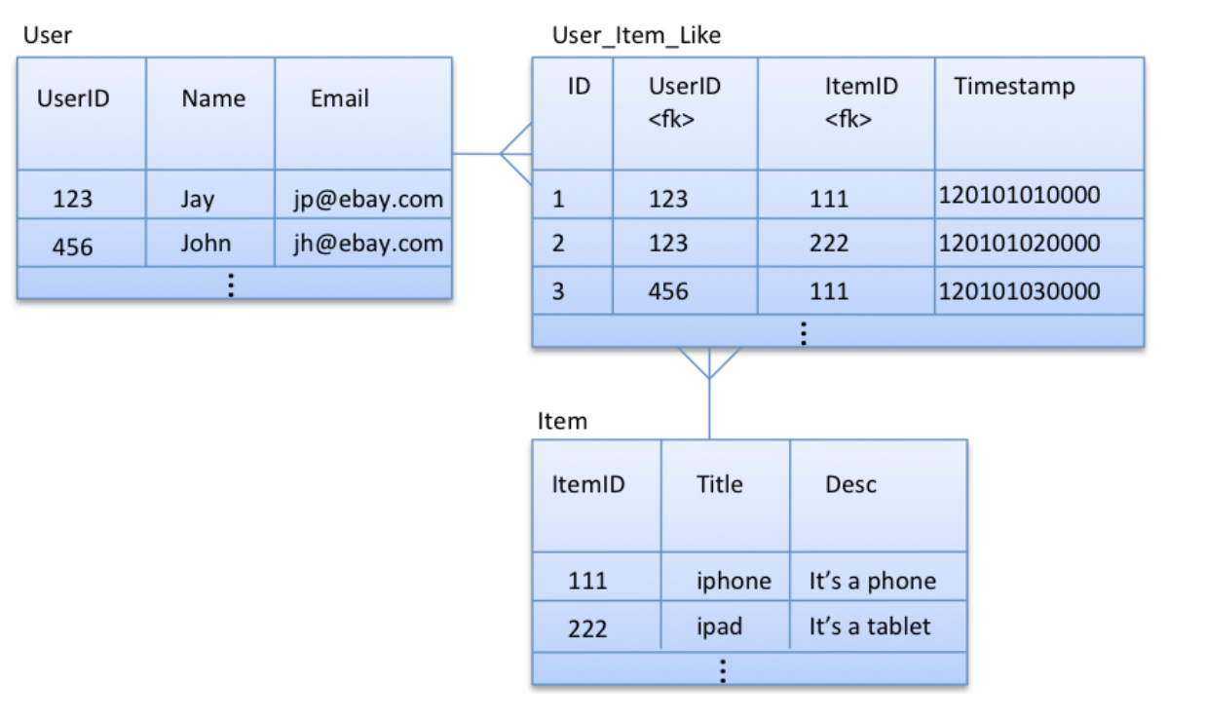
Example 1: Users “Like” Items
Support queries:
Get user by userId
Get item by itemID
Get all the items(id,title) that a particular user likes
Get all the users(id,name) who like a particular item

Slide 66
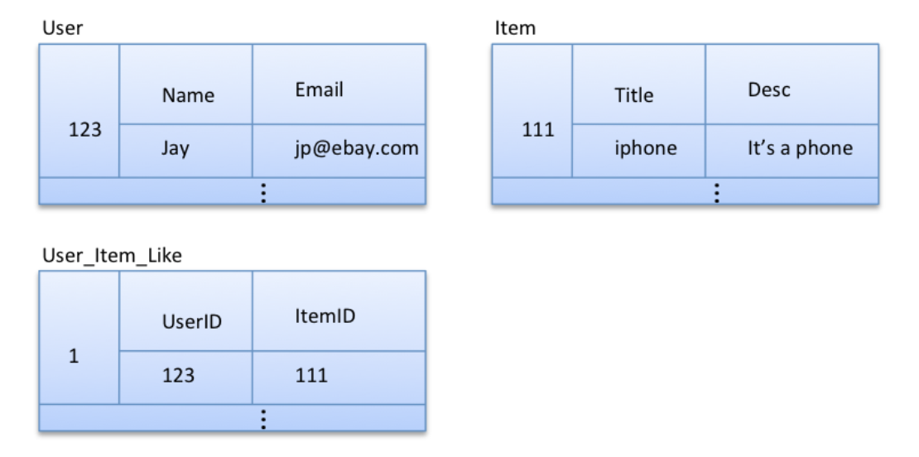
Option 1: Exact Replica of Relational Model
Identical to relational model
No easy way to query all the items that a particular user likes, or all the users who like a particular item
Inefficient due to lack of JOIN’s
Requires a full table scan of User_Item_Like, followed by(for each User_Item_Like row), reading one User row and one Item row

Slide 67
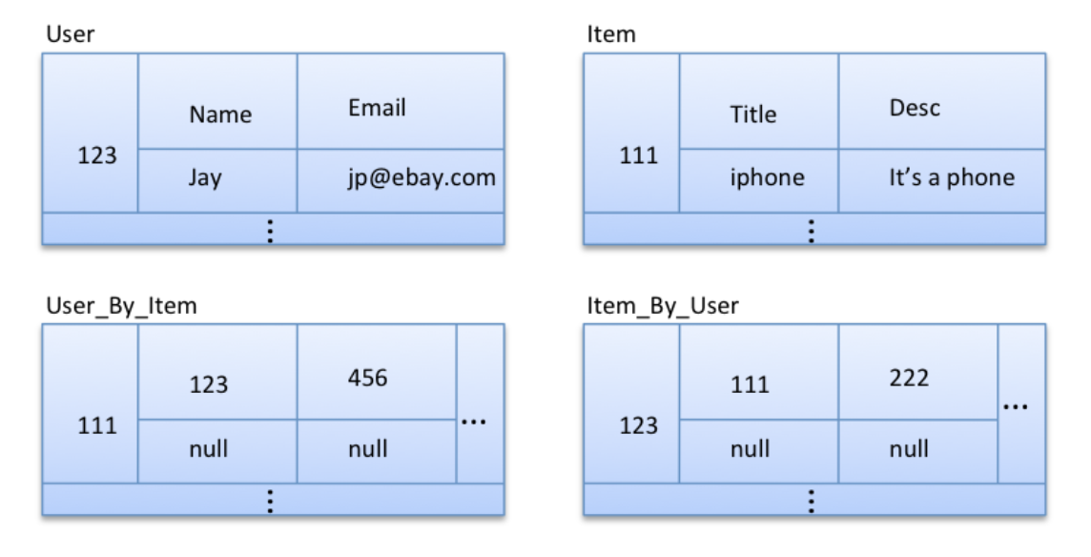
Option 2: Normalized entities with custom indexes
We can easily query all the items that a particular user likes, using Item_By_User, and all the users who like a particular item, using User_By_Item
But, we always want to get the item title in addition to the item id when we query items liked by a particular user.
In this model, we first need to query Item_By_User to get all the item ids that a given user likes, and then, for each item id, we need to query Item to get the title

Slide 68
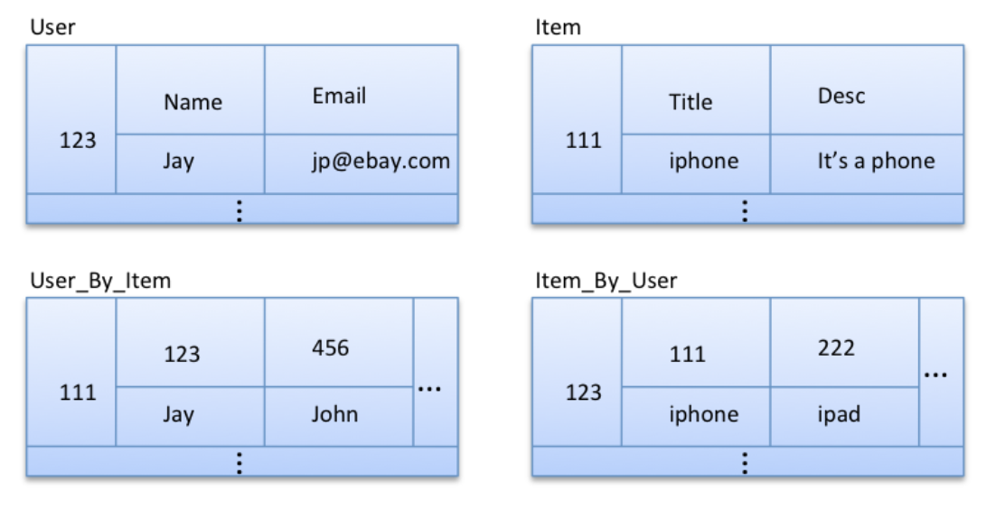
Option 3: Normalized entities with de-normalization into custom indexes
Title and username are de-normalized in User_By_Item and Item_By_User respectively
This allows us to efficiently query (by reading a single row) all the item titles liked by a given user, and all the user names who like a given item
Plus one read to get full information about the User/Item

Slide 69
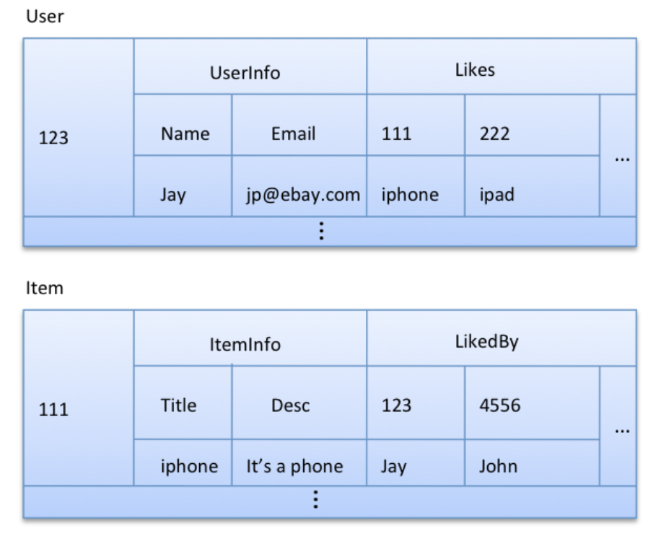
Option 4: partially de-normalized entities
More efficient: one read instead o two to get full information about a User/Item
But, much more repeated data: much wider rows, much harder to maintain
Probably a step too far in de-normalization – a lot more data just to save one read per query
Preference: Option 3

Slide 70
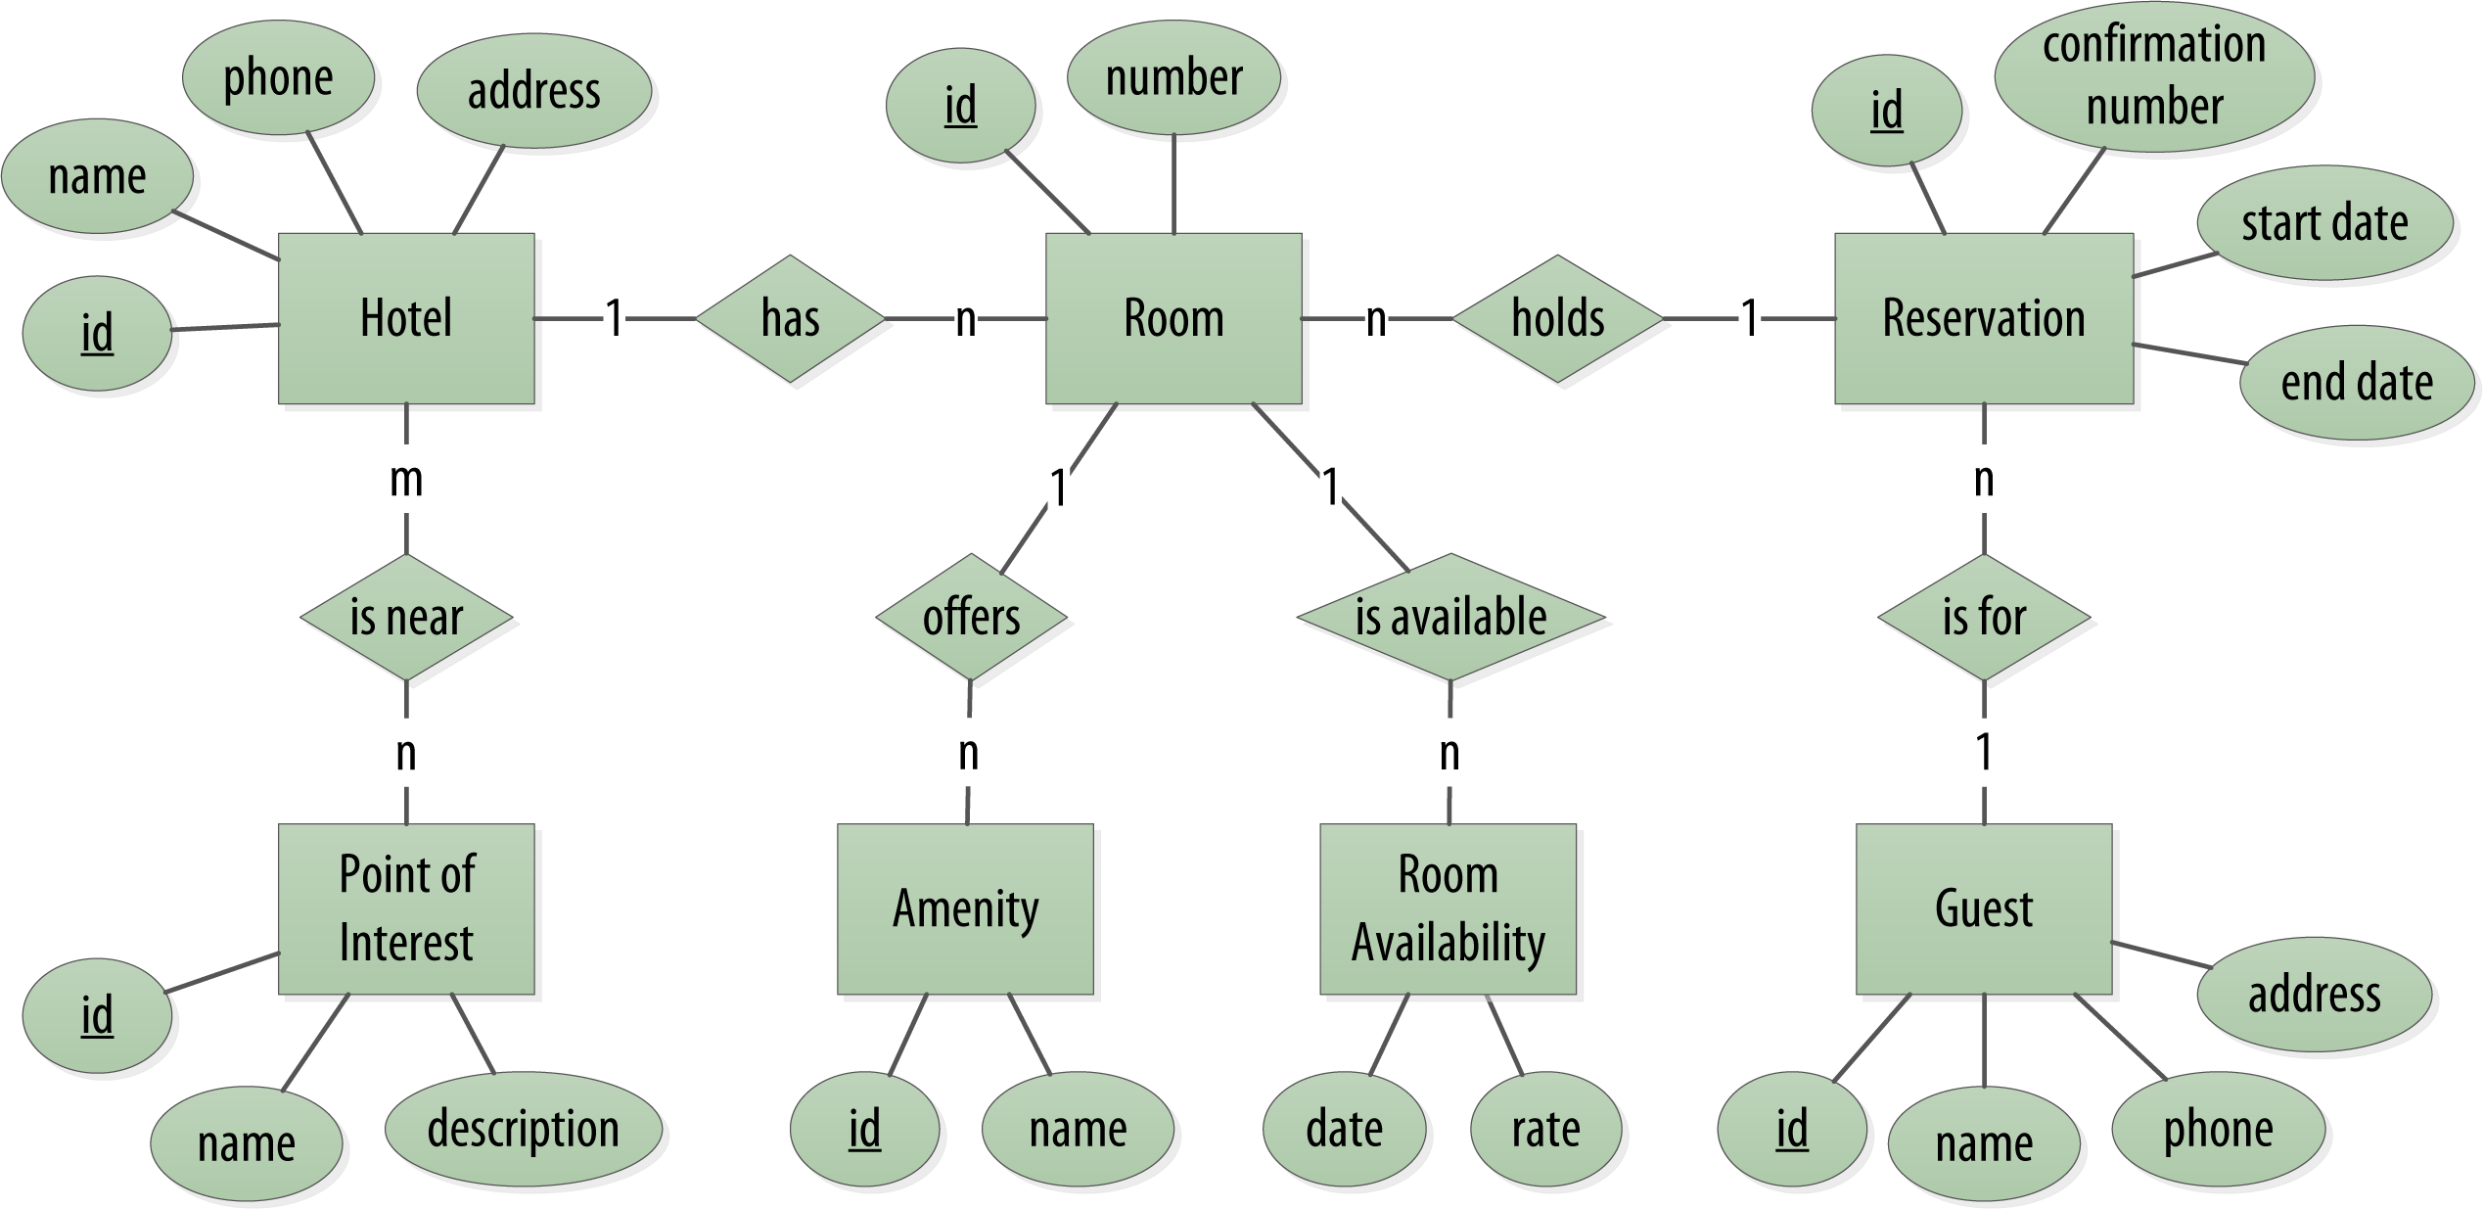
Hotel Booking Site

Slide 71
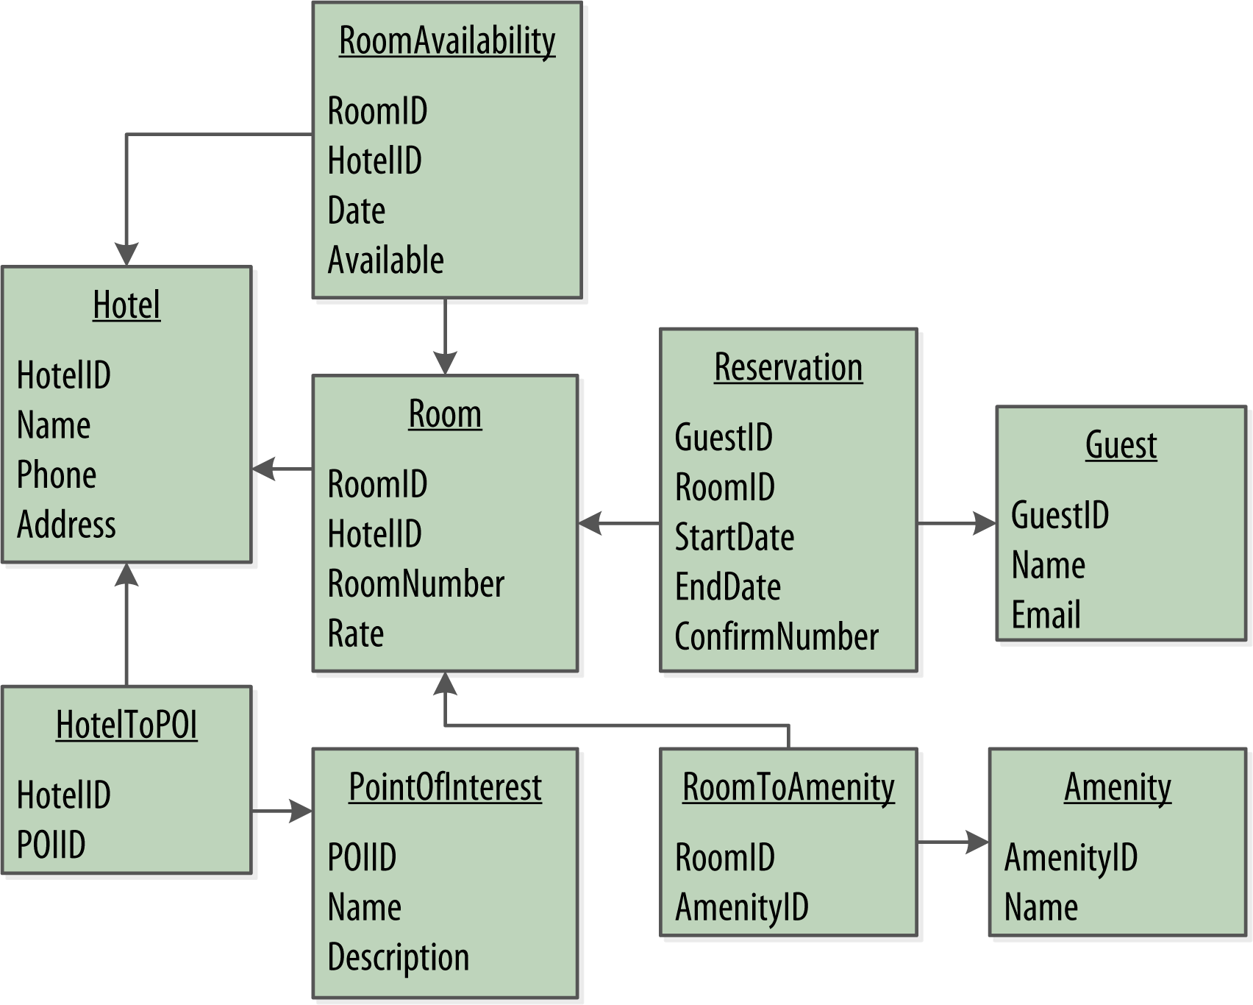
Relational Database Model

Slide 72
Cassandra Design
No Joins
Use denormalization instead
No Referential Integrity
No foreign keys
No transactions across multiple rows
Use Query First Design
ER Model first to understand the data
Model the queries in your app
Let the data organize around the queries

Slide 73
Hotel Booking Site - Queries
Q1. Find hotels near a given point of interest.
Q2. Find information about a given hotel, such as its name and location.
Q3. Find points of interest near a given hotel.
Q4. Find an available room in a given date range.
Q5. Find the rate and amenities for a room.
Q6. Lookup a reservation by confirmation number.
Q7. Lookup a reservation by hotel, date, and guest name.
Q8. Lookup all reservations by guest name.
Q9. View guest details.

Slide 74
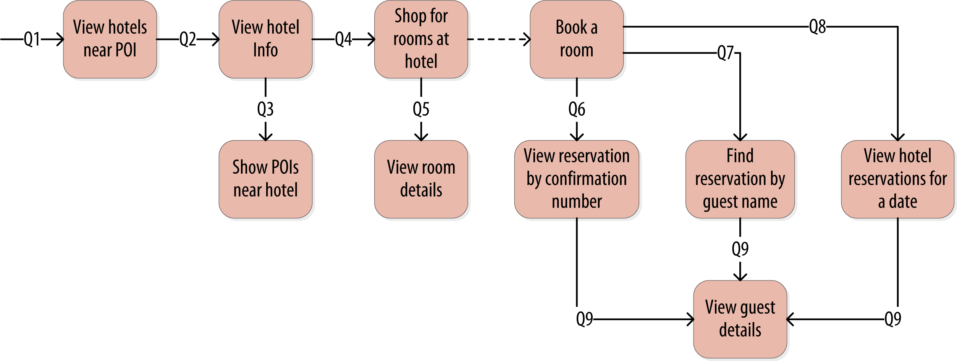
Hotel Booking Site - Queries

Slide 75
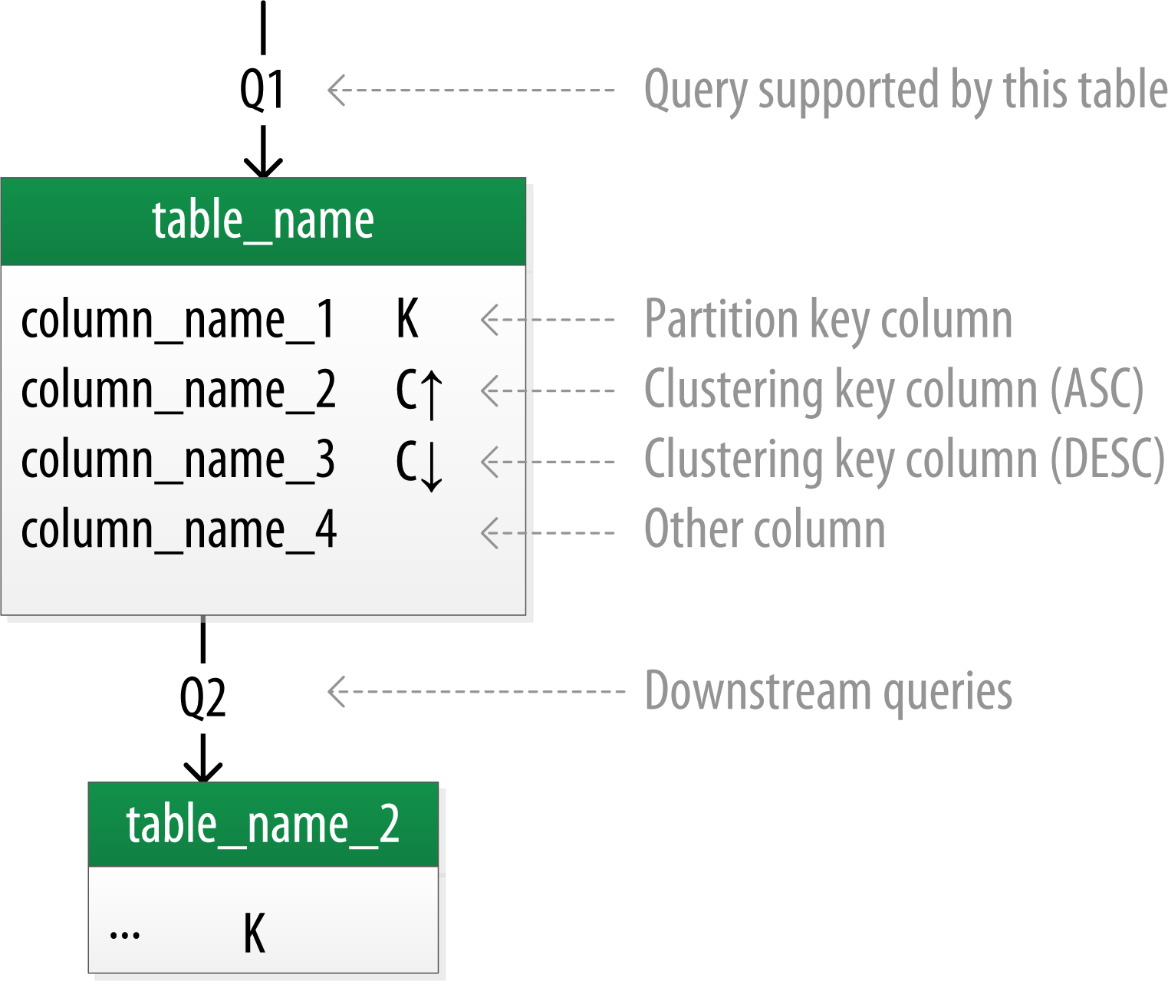
Chebotko Diagram
Captures the database schema
together with the workflow

Slide 76
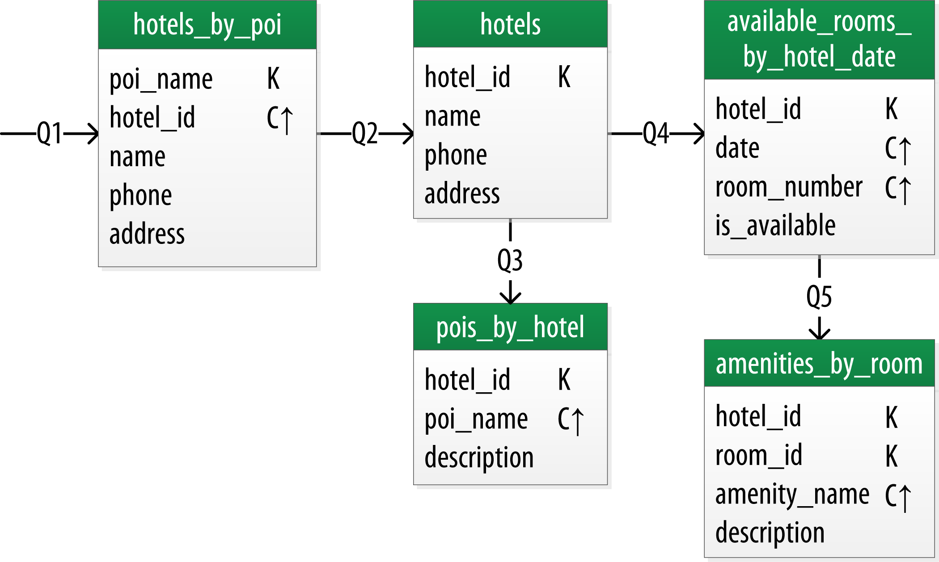
Hotel Logical Data Model
Notice the duplication for faster queries
Q1 & Q3
Notice Rooms and Amenities are not in separate tables
Query didn’t ever need just rooms
What about Q4? Find available room given a date
What are the implications? – a lot of data
Other approaches?
Notes:
At this point, let’s now consider how to support query Q4 to help the user find available rooms at a selected hotel for the nights they are interested in staying. Note that this query involves both a start date and an end date. Because you’re querying over a range instead of a single date, you know that you’ll need to use the date as a clustering key. Use the hotel_id as a primary key to group room data for each hotel on a single partition, which should help searches be super fast. Let’s call this the available_rooms_by_hotel_date table.
To support searching over a range, use clustering columns to store attributes that you need to access in a range query. Remember that the order of the clustering columns is important.
The design of the available_rooms_by_hotel_date table is an instance of the wide partition pattern. This pattern is sometimes called the wide row pattern when discussing databases that support similar models, but wide partition is a more accurate description from a Cassandra perspective. The essence of the pattern is to group multiple related rows in a partition in order to support fast access to multiple rows within the partition in a single query.

Slide 77
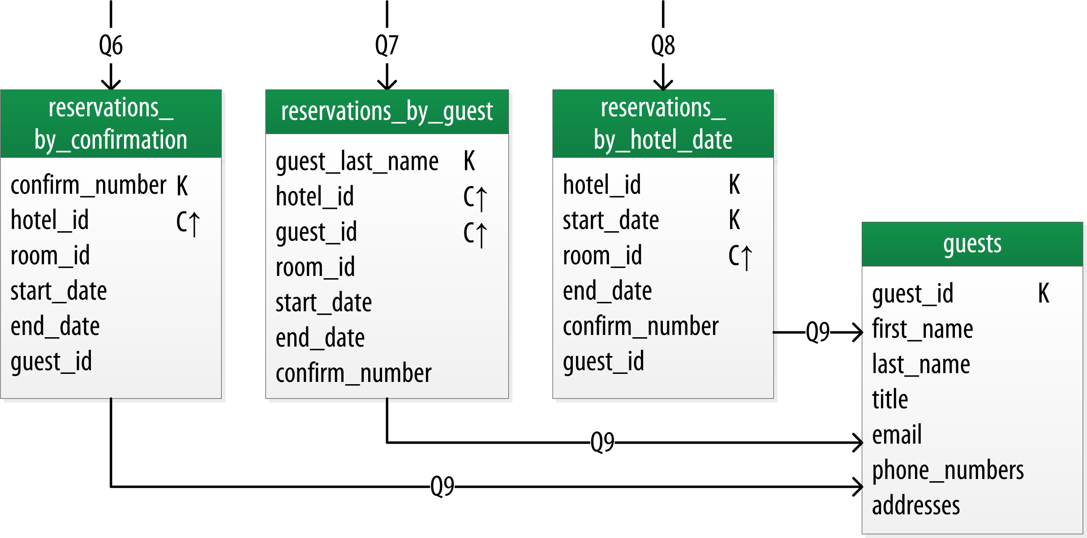
Reservation Logical Data Model

Slide 78
Row Keys and Hot Spots
Choose the proper row key – it’s your “shard key”
Otherwise you’ll end up with hot spots, even using RandomPartitioner
Example: storing time series data which is retrieved based on hour
Idea 1: Row key = the hour: a terrible idea
All the writes in a given hour will go to a single node holding the row for the current hour – a hotspot
Idea 2: Row key = the minute: no improvement
Only one node will be writing during whatever duration you pick!
As time progresses the hot spot moves, but it never goes away
This is a recurring dilemma in Cassandra data modelling, between taking advantage of column ordering and avoiding hotspots

Slide 79
Row Keys and Hot Spots
Idea 3: Add something else to the row key, e.g., event type, machine id
Whatever is appropriate for your use case
But what if you have nothing else to add, or you absolutely need time period as the only row key?
Idea 4: Manually split row keys based on number of nodes in the Cassandra cluster
E.g., “yyyymmddhh|1”, “yyyymmddhh|2”, …
For an hour window, each node will now evenly handle the writes in round-robin
Issue: Reading data for a given hour will require multi-get from all the physical nodes followed by a merge in the client application
Issue: What if the number of nodes in the cluster changes?
Proposed solution: store the cluster size over time in a C* table

